Slide 1
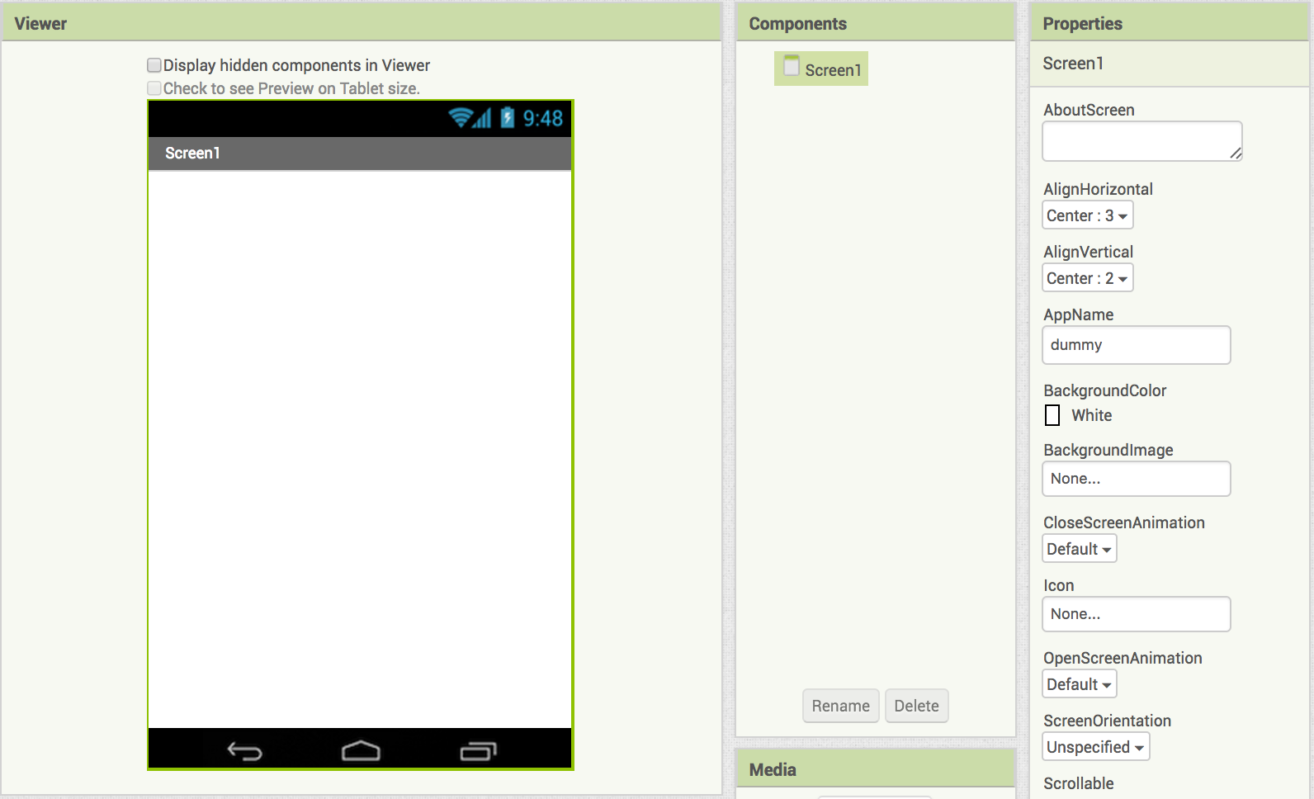
App Inventor Intro: HelloPurrWoof
Start a new project in App Inventor and name it HelloPurrWoof.
Click on Screen one and set
AlignHorizontal to Center: 3
AlignVertical to Center: 2

Slide 2
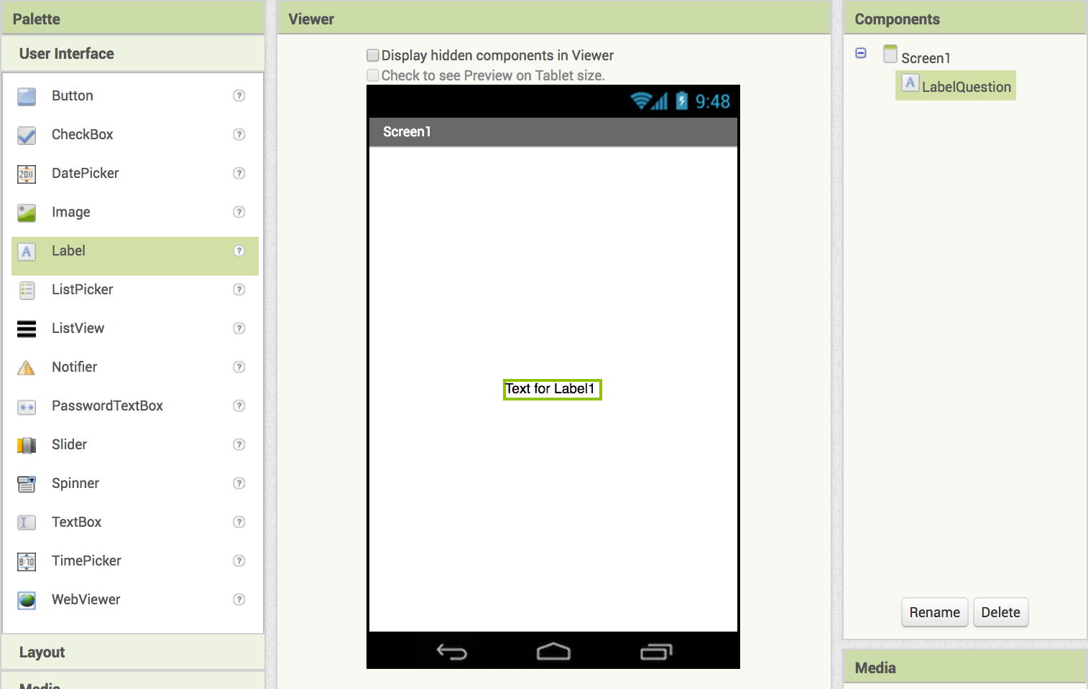
App Inventor Intro: HelloPurrWoof
Add a label and rename it LabelQuestion

Slide 3
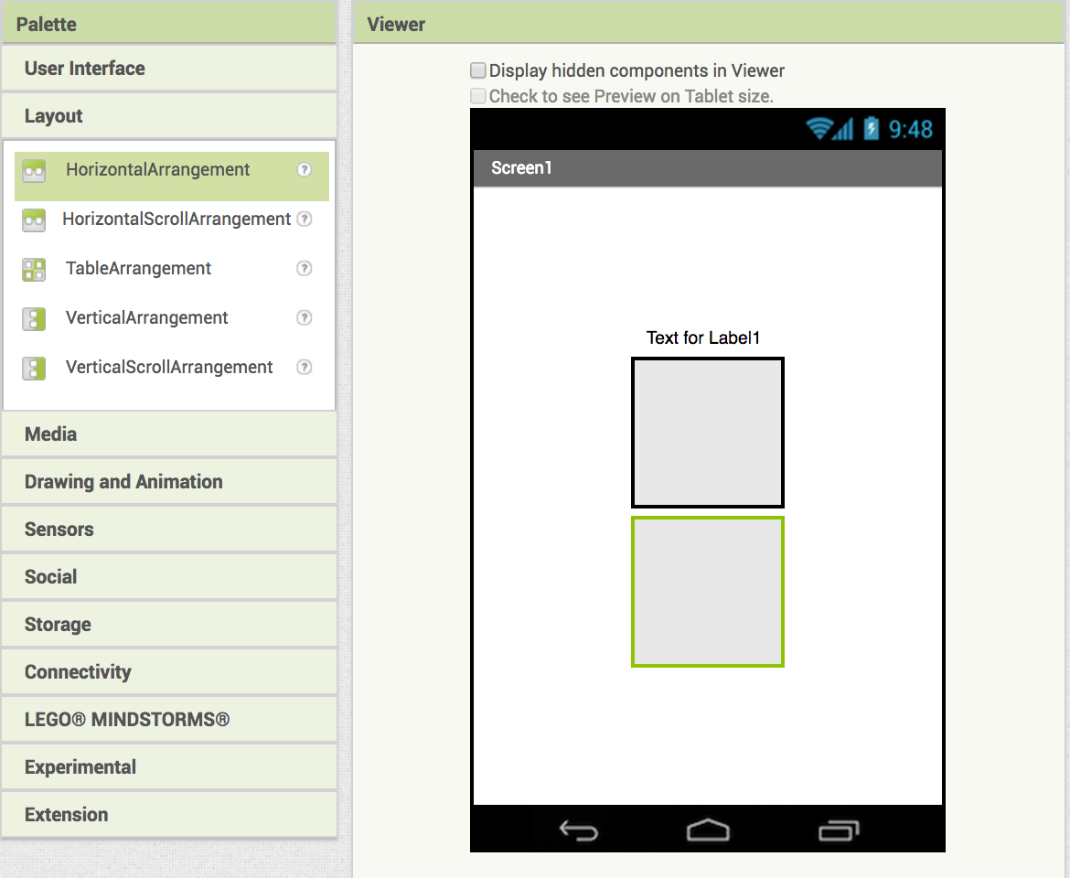
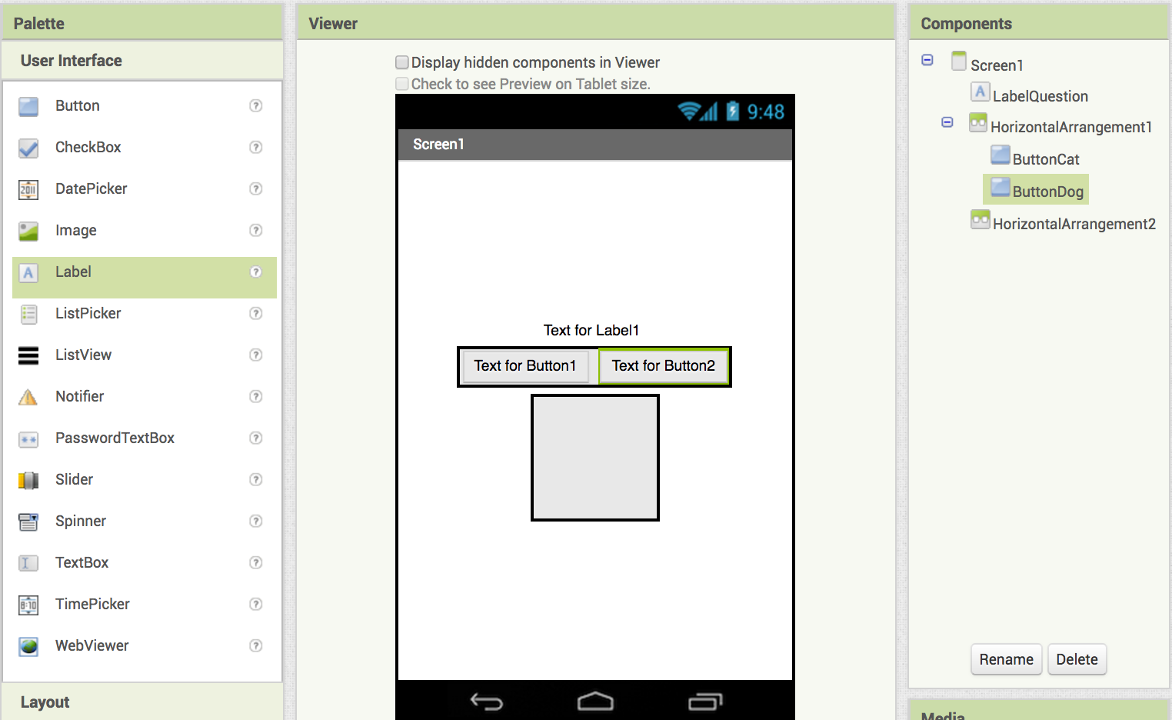
Drag in two HorizontalArrangements
In the top HorizontalArrangement add button and rename it ButtonCat.
Add a second button and rename it ButtonDog

Slide 4
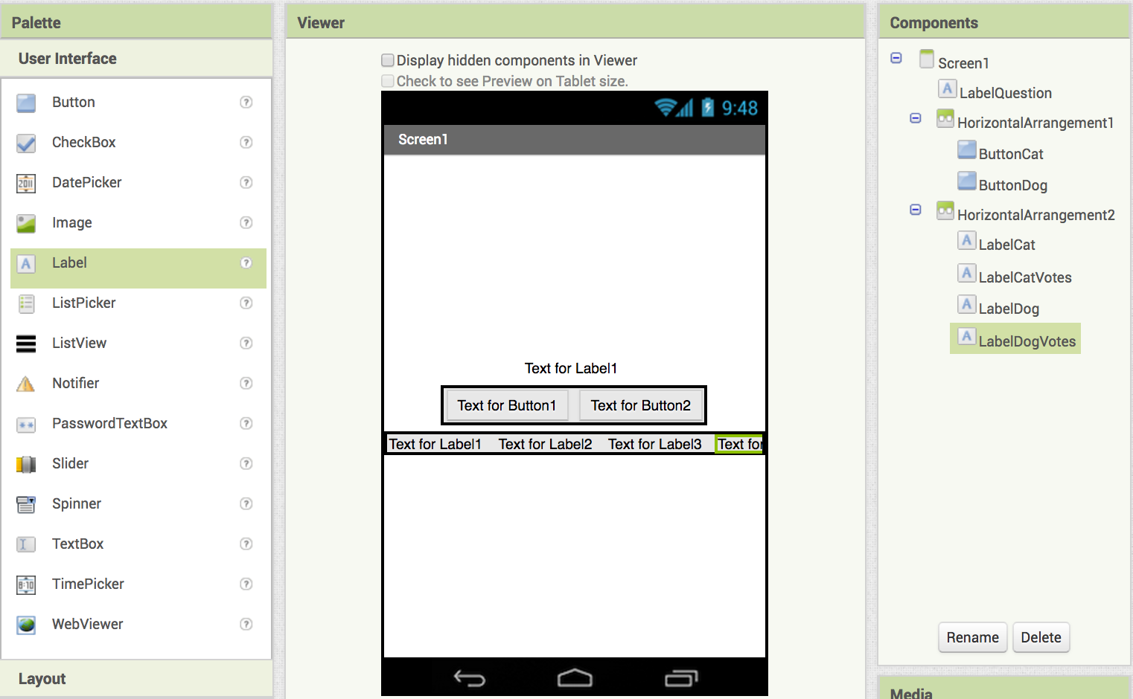
Set the bottom HorizontalArrangement width to FillParent
Add 4 labels and rename them:
LabelCat
LabelCatVotes
LabelDog
LabelDogVotes

Slide 5
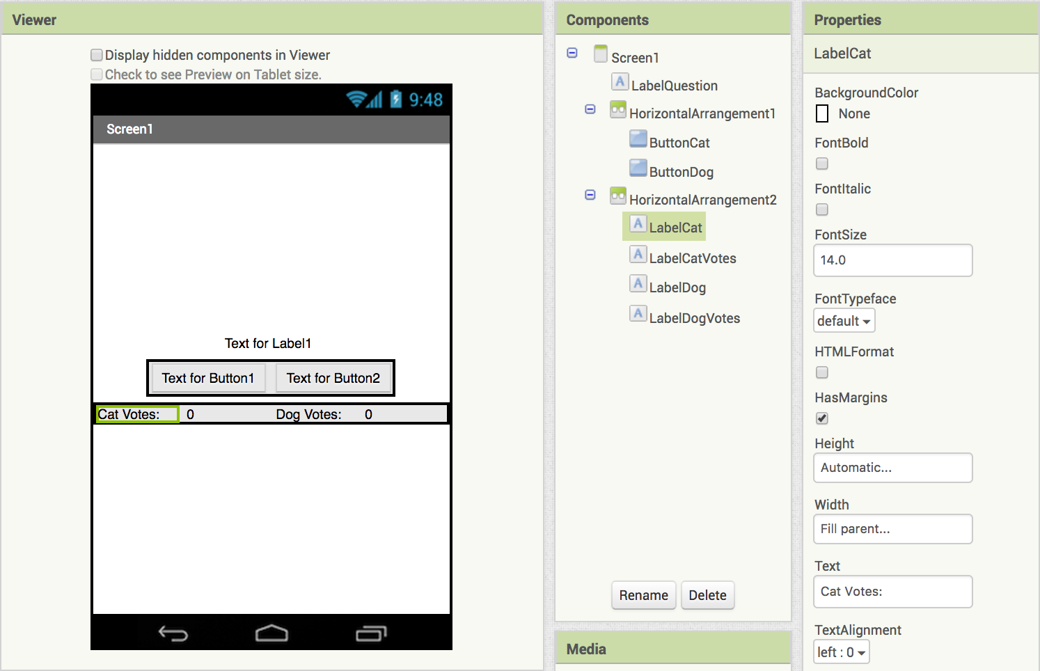
Set LabelCat width to FillParent
Change the Text to "Cat Votes:"
Set LabelCatVotes width to FillParent
Change the Text to "0"
Set LabelDog width to FillParent
Change the Text to "Dog Votes:"
Set LabelDogVotes width to FillParent
Change the Text to "0"

Slide 6
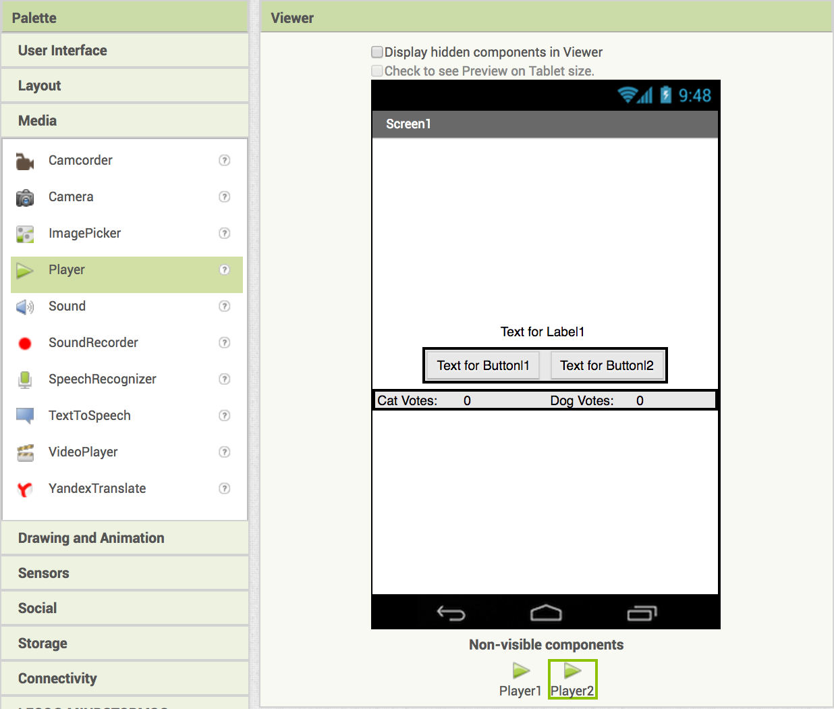
Now we need to set up our app to play sounds.
Drag in 2 Player components from the Media drawer
After you drag in the Players, they will appear here.

Slide 7
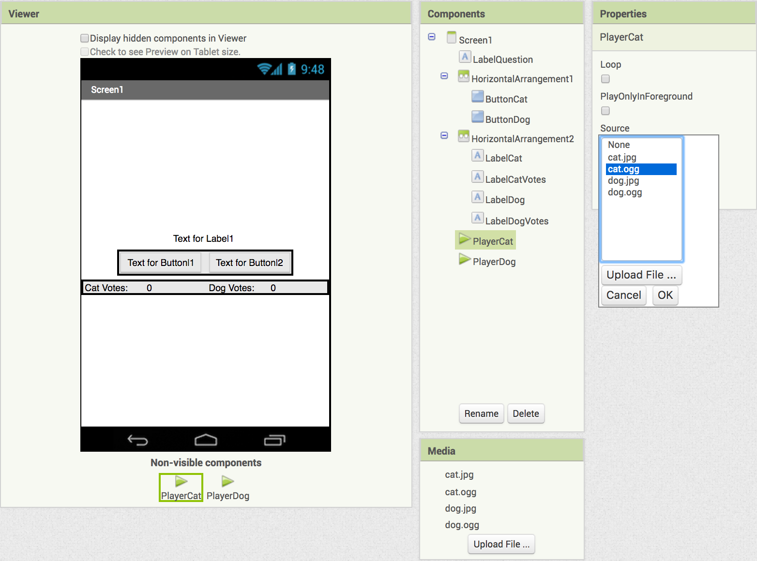
Let's set the sounds for the Players!
First, rename Player1 to PlayerCat.
In the Properties panel click on Source
Choose cat.ogg
Next, rename Player2 to PlayerDog.
In the Properties panel click on Source
Choose dog.ogg

Slide 8
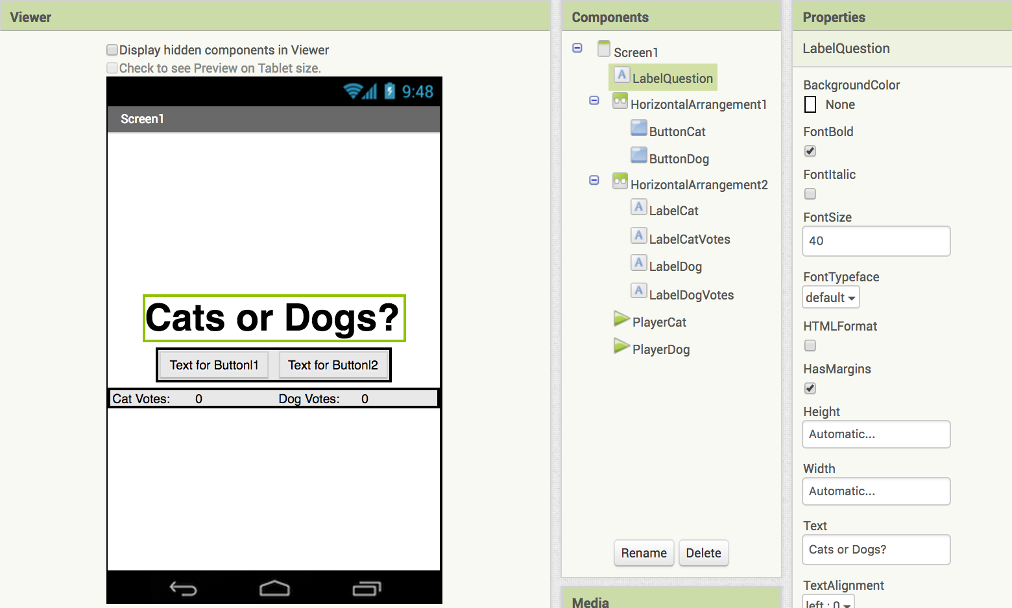
Let's update the LabelQuestion!
Select
Set to 40
Your LabelQuestion should now look like this.
Change text to:
Dogs or Cats?

Slide 9
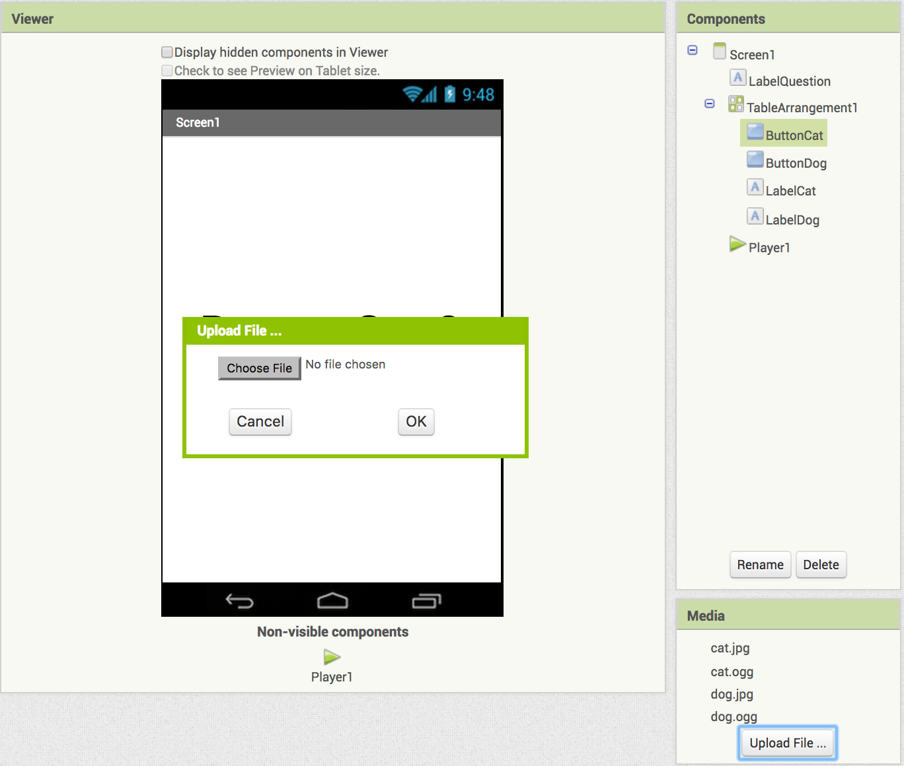
Upload the pictures and sounds for our app.
Download each of these files to your computer:
cat.jpg (our cat image)
cat.ogg (our cat sound)
dog.jpg (our dog image)
dog.ogg (our dog sound)
Your uploaded files should appear below
Under media, click on Upload File… then Choose File, find the images and sounds and upload them to your computer.

Slide 10
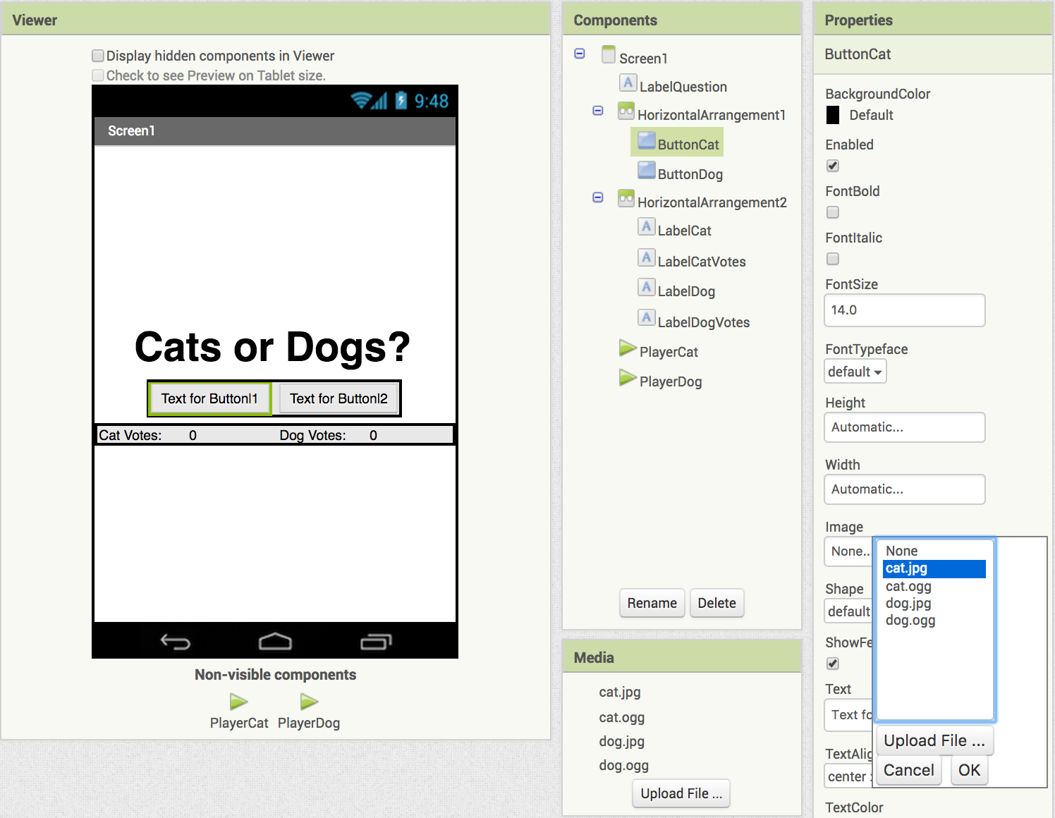
Set the pictures for ButtonCat and ButtonDog.
Under the Properties for ButtonCat click Image
choose cat.jpg

Slide 11
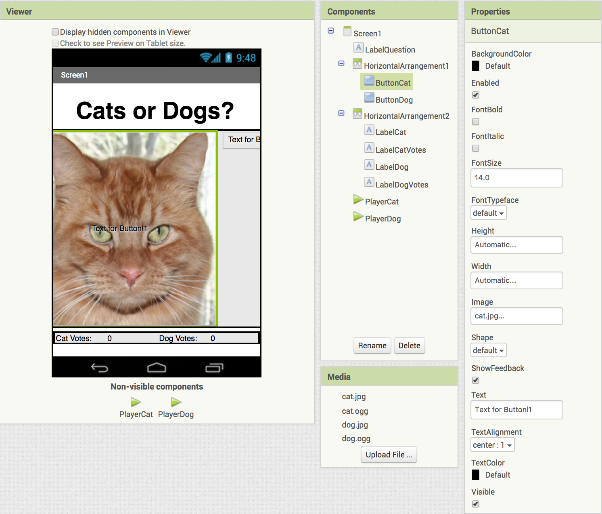
Your screen should look like this.
Let's fix the cat so it fits the screen!

Slide 12
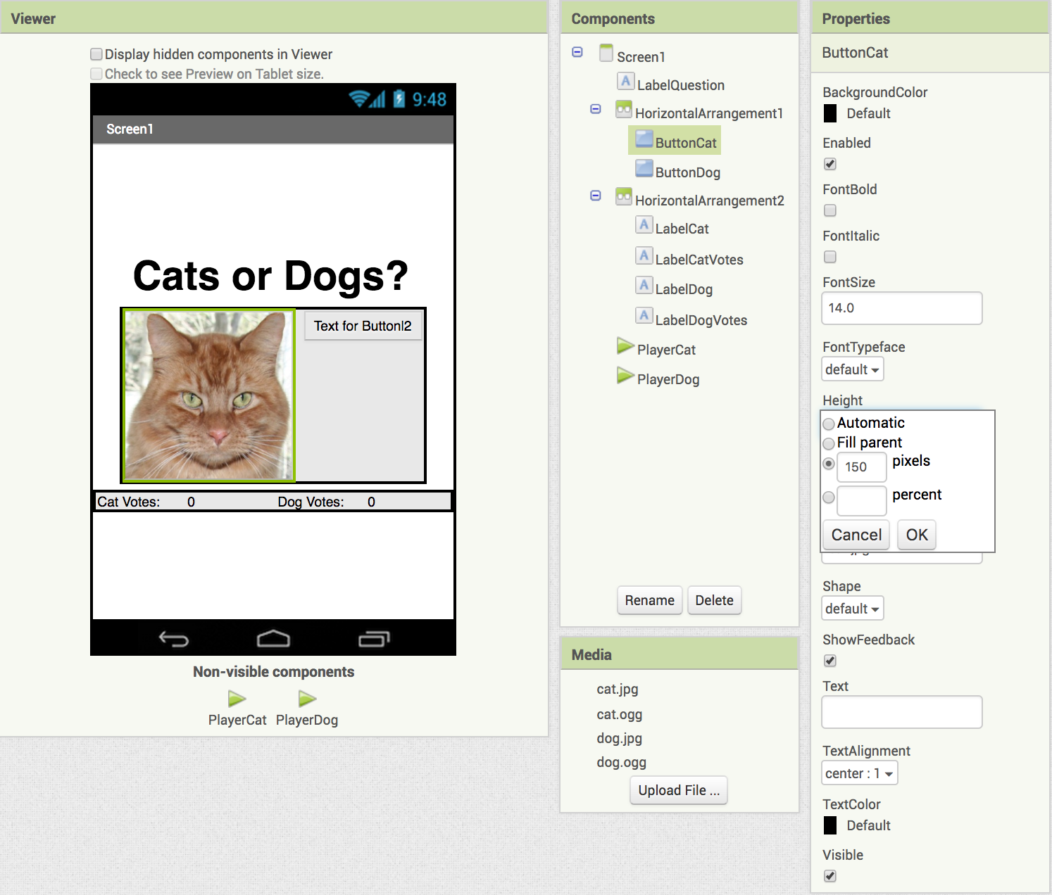
Set the image's height and width.
Under Properties, click on Height - set it to 150 pixels
Do the same for Width
Erase the words under Text
Your ButtonCat should now look like this.

Slide 13
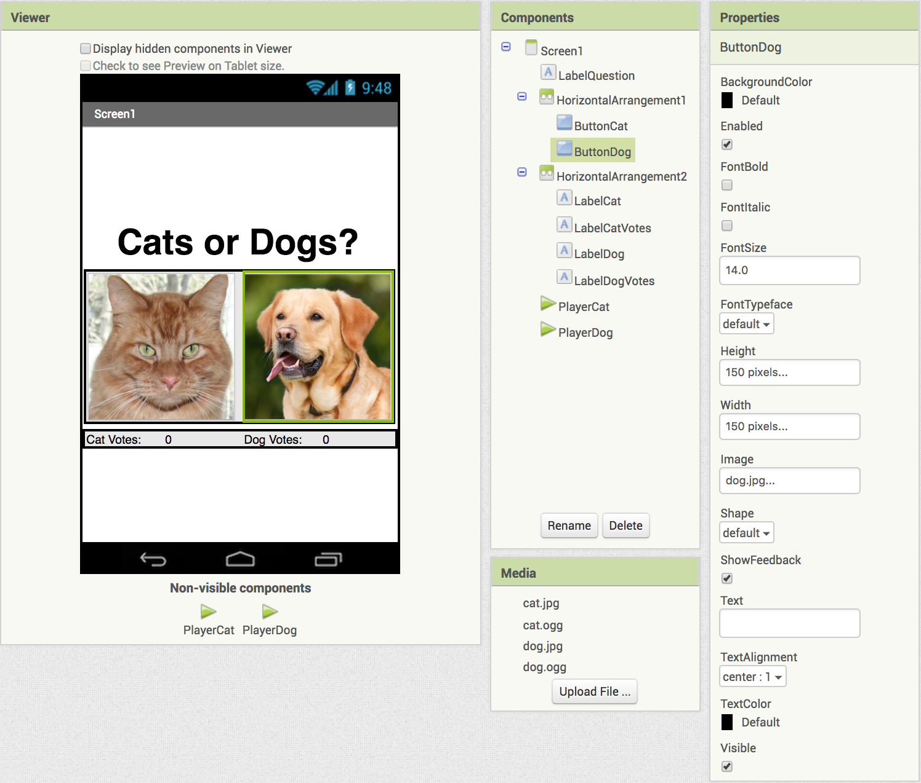
Repeat the steps for ButtonDog.
Select the dog.jpg Image
Set the Height and Width to 150 pixels
Erase the words under Text
Your screen should now look like this.

Slide 14
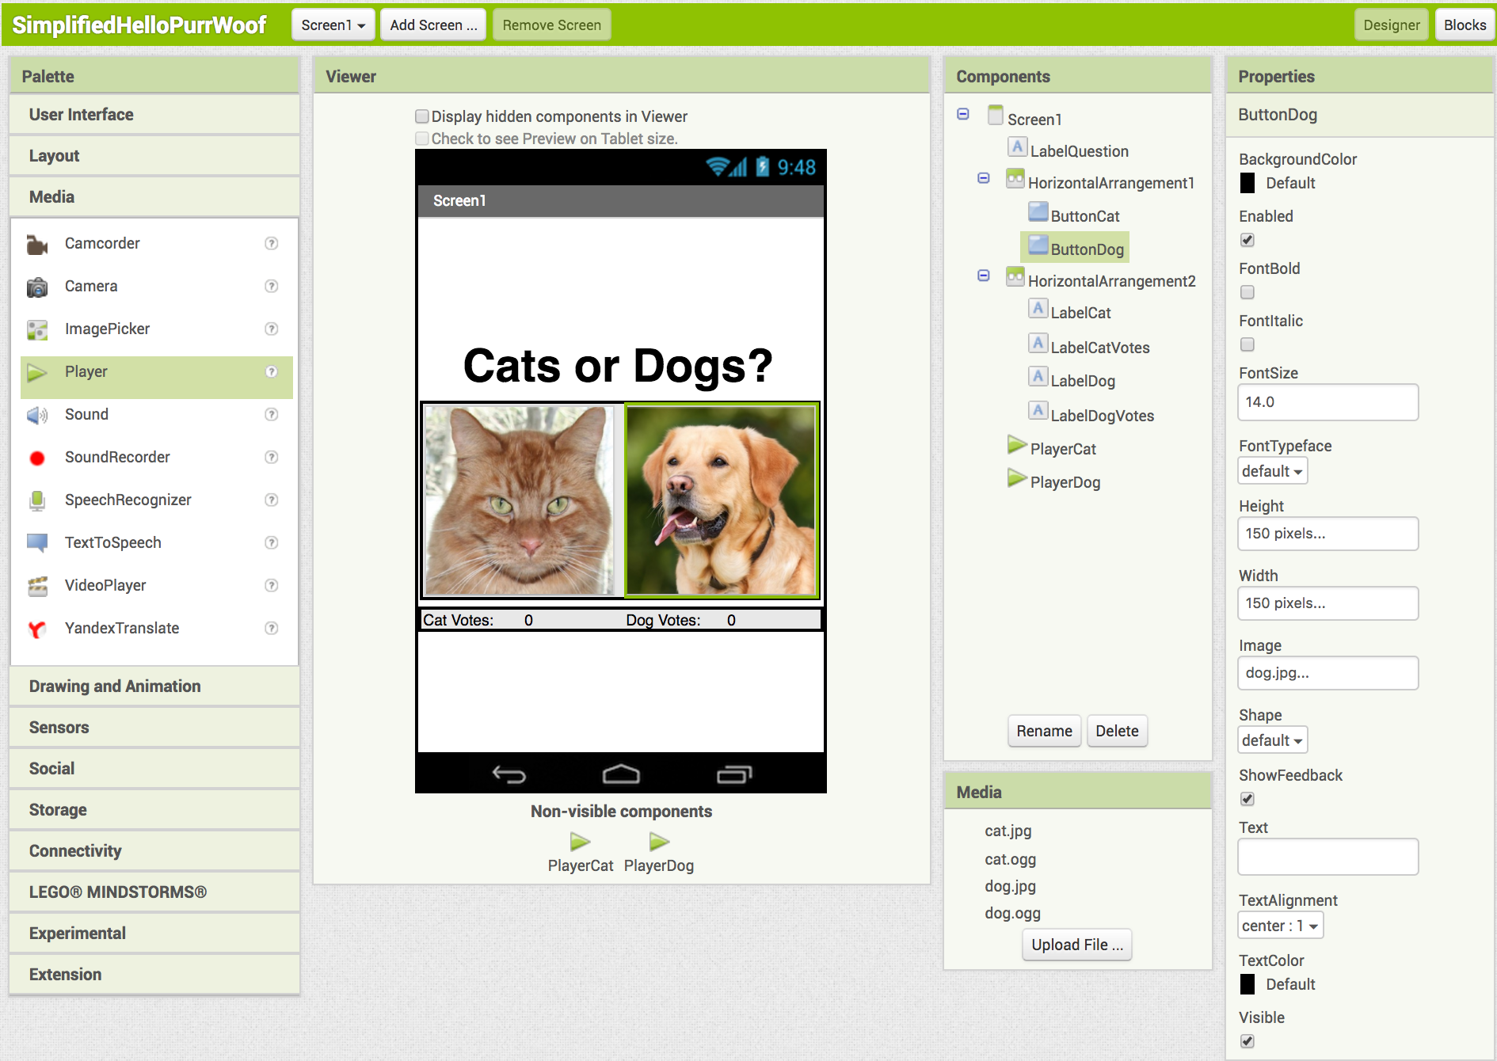
It’s time to code our app! Switch to the Blocks window (top right corner).

Slide 15
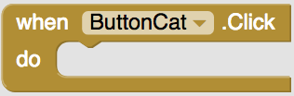
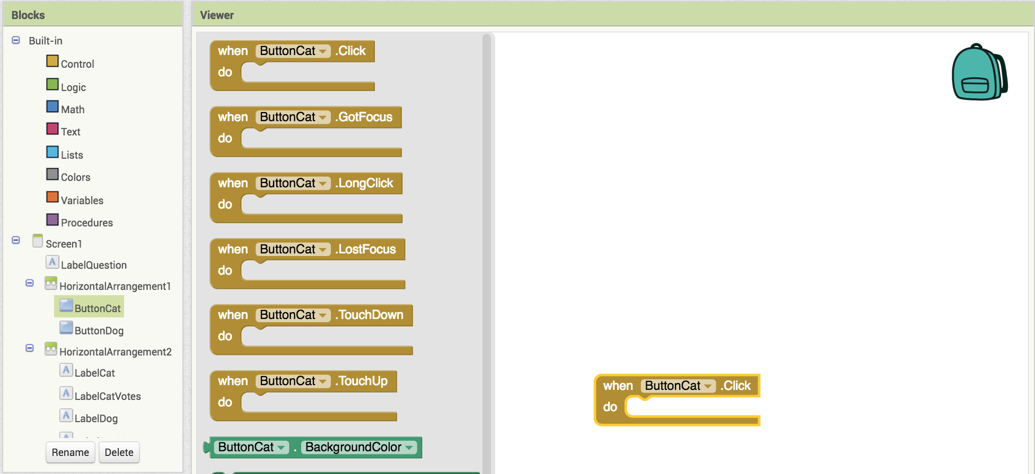
Programming the vote buttons.
Click on ButtonCat
Drag out
(this triggers an action when someone presses ButtonCat)

Slide 16

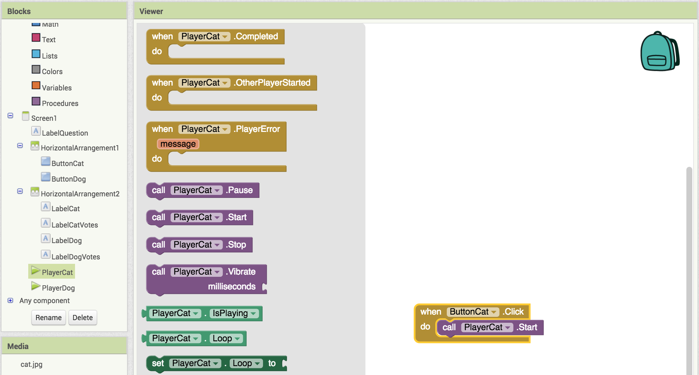
Making a sound play.
Click on PlayerCat.
Drag out and add it to
(this makes the player play the sound)

Slide 17

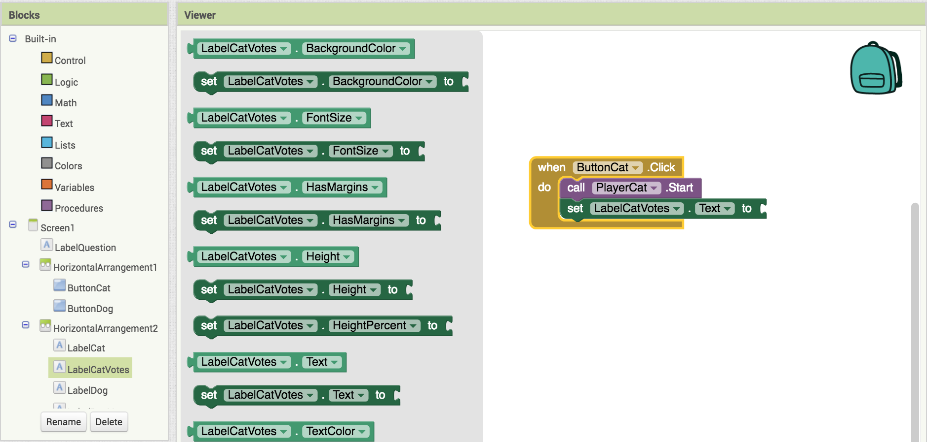
Adding the votes.
Click on LabelCatVotes.
Drag out add it to

Slide 18


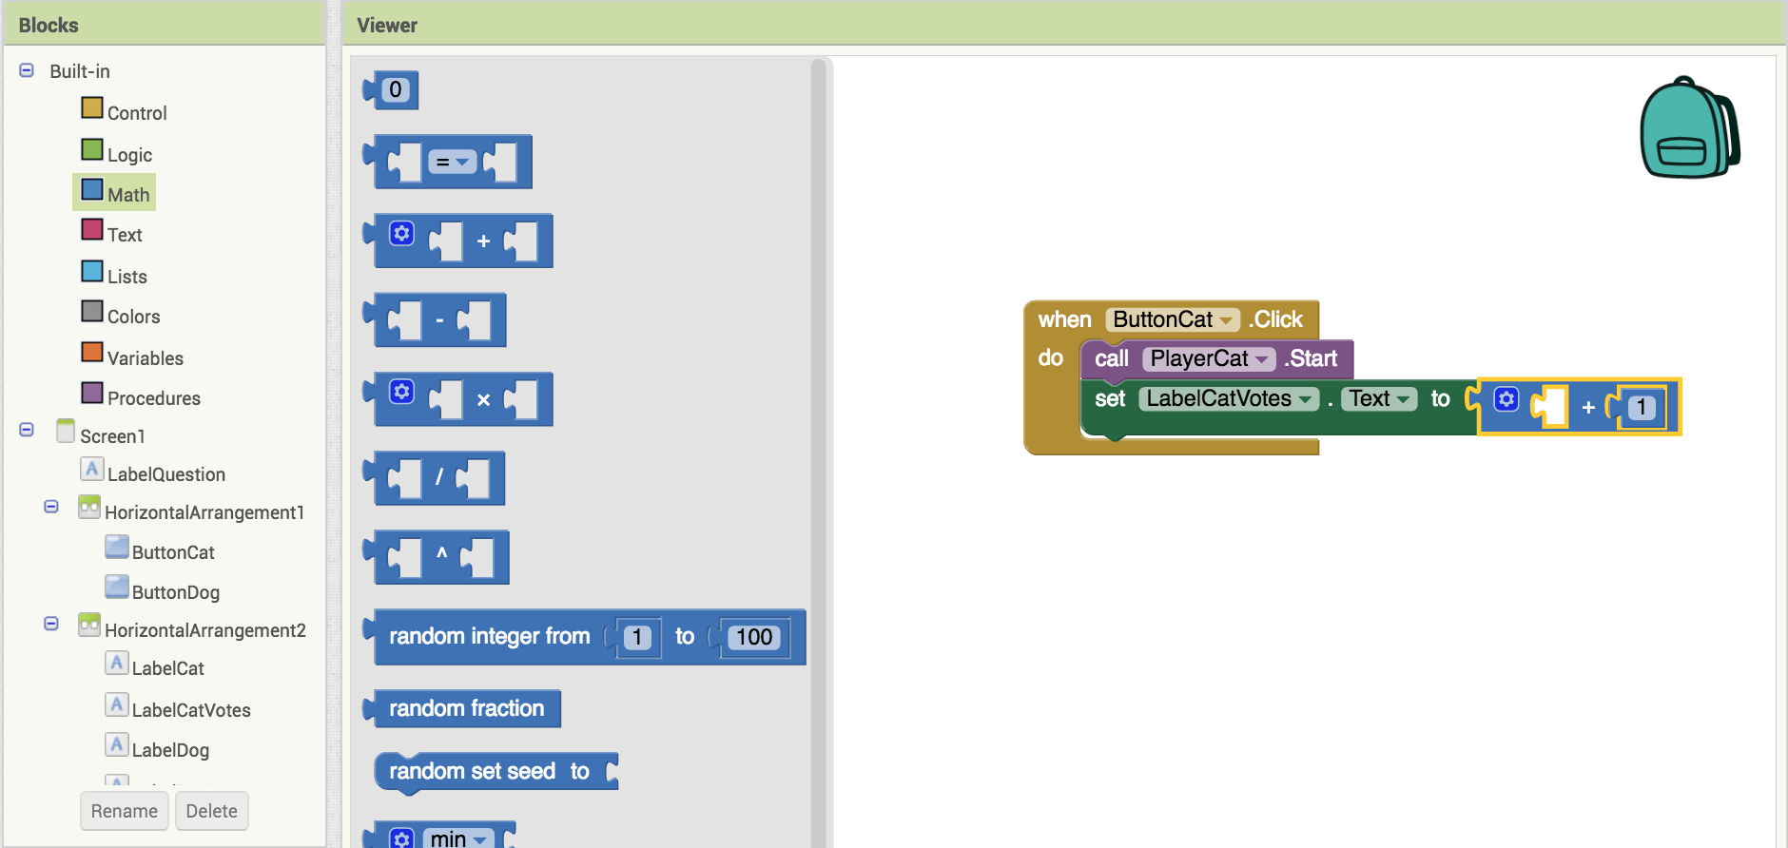
Adding the votes.
Click on Math.
Drag out and and add them to
Click on and change its value to 1

Slide 19


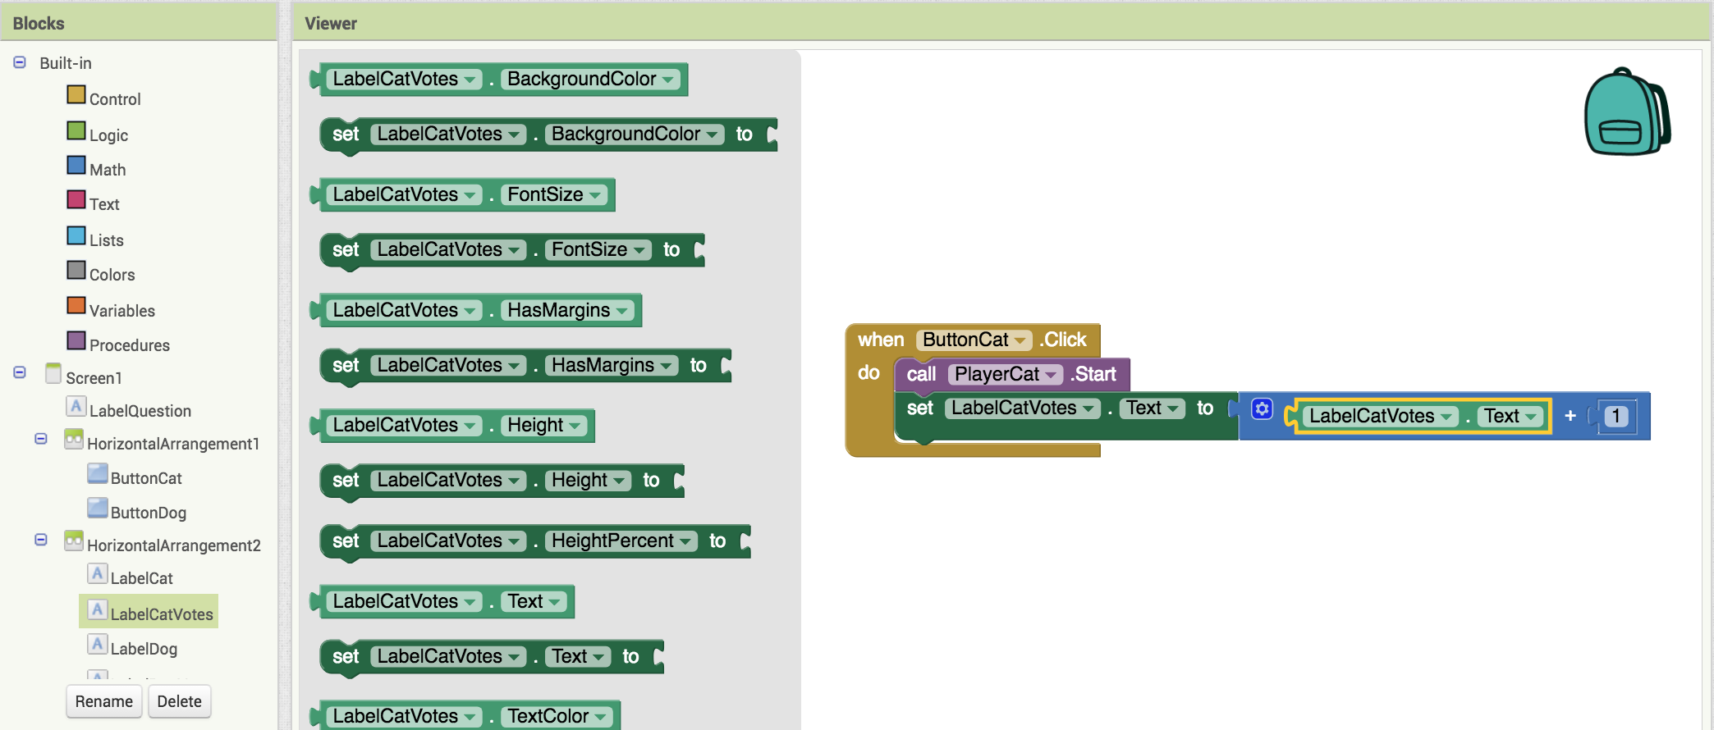
Adding the votes.
Click on LabelCatVotes.
Drag out and add it to
Now test it out and see if the cat meows and the votes change!

Slide 20

Complete the code for Dogs!
Do the same things you did for the for
When you're done test it out and collect votes from your friends!

Slide 21
Further Exploration Questions
What are some other ways we could increment CatVote and DogVote?
Could we use one player instead of two players to play the sounds? What else in the code would have to change if we used two players?
Is there anything to stop someone from voting 20 times?
What would we have to add so that we can click a button and “reset” the votes back to zero?
Change the app to be about something else other than voting on cats or dogs. What else could an app like this be used for?

